Slide 1
Introducing Psychology
By Ms. Sumaira Ayub
Lecturer, Department of Applied Psychology, SPP

Slide 2
Understanding about behavior
Everyone wants to know about oneself and other people around him.
Psychology requires scientific approach
Natural settings, laboratories, schools, colleges, universities, parks, markets, organizations……. Every social setting.
Study about HOW, WHAT and WHY of human behavior.

Slide 3
Psychology………….. Psyche (soul/mind)
Logy (study)
Psychology as a soul
Psychology as a mind
Psychology as mental processes
Psychology as behavior

Slide 4
Definition
The scientific study of behavior and mental processes. It encompasses not just what people do but also their thoughts, emotions, perceptions, reasoning processes, memories, and even the biological activities that maintain bodily functioning.
Scientific study
Mental processes
Behavior

Slide 5
Goals of psychology
To Describe
The first goal of psychology is to describe how humans and animals behave in different situations. Through continued observation we can define what kind of behavior is considered normal or healthy and what may be seemed as abnormal or unhealthy.
To Explain
Why does this behavior occur? Under what circumstances will it occur again? In order to explain a behavior, psychologists must conduct experiments to ensure that the behavior is not an anomaly. They have to consider which factors trigger certain behavior, as well as formulate certain theories which will help explain the same.

Slide 6
To Predict
Based on past observed behavior, a psychologist aims to predict how that behavior will appear again in the future and if other people will exhibit the same behavior. Being able to correctly predict occurrences of certain behavior is very important, as with this understanding, models can be developed to encourage positive behavior and find methods to modify or control negative behavior.
To Control
The final goal of psychology is to control or modify certain types of behavior based on observation.

Slide 7
Example
Someone did something that they weren't supposed to do that had a negative impact on their life. You want to try to help/solve the problem and naturally, the following questions might run through your mind:
"What happened?" (describing),
"Why did she do that?" (explaining),
"What would happen if she did this?" (predicting)
"What can she do next time to have a different outcome?" (changing).
The main difference between us asking these questions and psychologists and professional mental health professionals asking these questions is that there is a high level of education and training in the explaining, predicting and changing process that facilitates lasting positive change for individuals.

Slide 8
Importance of psychology
Better understanding of your own self (development, personality, thoughts and behavior)
Better understanding of people around you. (building relationships)
Better communicator
Better leader (self confidence)
Better friend
Avoiding stressful situations
Coping and resilience

Slide 9
Difference between Psychologist and Psychiatrist
Psychologist: focus extensively on psychotherapy and treating emotional and mental suffering in patients with behavioral intervention.
Psychologists obtain PsyD doctoral degree, Throughout their education, psychologists study personality development, the history of psychological problems and the science of psychological research.
Psychiatrist: are trained medical doctors, they can prescribe medications, and they spend much of their time with patients on medication management as a course of treatment.
Psychiatrists attend medical school and are trained in general medicine. After earning an MD, they practice four years of residency training in psychiatry.

Slide 10
The Subfields of Psychology: Psychology’s Family Tree
Clinical psychology deals with the study, diagnosis, and treatment of psychological disorders.
Clinical neuropsychology unites the areas of biopsychology and clinical psychology, focusing on the relationship between biological factors and psychological disorders.
Cognitive psychology focuses on the study of higher mental processes including thinking, memory, reasoning, problem solving, judging, decision making, and language.

Slide 11
Counseling psychology focuses primarily on educational, social, and career adjustment problems.
Cross-cultural psychology investigates the similarities and differences in psychological functioning in and across various cultures and ethnic groups.
Developmental psychology examines how people grow and change from the moment of conception through death.

Slide 12
Educational psychology is concerned with teaching and learning processes, such as the relationship between motivation and school performance.
Environmental psychology considers the relationship between people and their physical environment.
Evolutionary psychology considers how behavior is influenced by our genetic inheritance from our ancestors.

Slide 13
Experimental psychology studies the processes of sensing, perceiving, learning, and thinking about the world.
Forensic psychology focuses on legal issues, such as determining the accuracy of witness memories.
Health psychology explores the relationship between psychological factors and physical ailments or disease.

Slide 14
Industrial/organizational psychology is concerned with the psychology of the workplace.
Personality psychology focuses on the consistency in people’s behavior over time and the traits that differentiate one person from another.
Behavioral neuroscience examines the biological basis of behavior. It mainly examines how the brain and the nervous system, other biological processes determine behavior.

Slide 15
School psychology is devoted to counseling children in elementary and secondary schools who have academic or emotional problems.
Social psychology is the study of how people’s thoughts, feelings, and actions are affected by others.
Sport psychology applies psychology to athletic activity and exercise.

Slide 16
Cyber psychology focuses on the psychological phenomena which emerge as a result of the human interaction with digital technology, particularly the Internet

Slide 17
Where do Psychologists work?
Many doctoral-level psychologists are employed by institutions of higher learning (universities and colleges) or are self-employed, usually working as private practitioners treating clients
Other work sites include hospitals, clinics, mental health centers, counseling centers, government human-services organizations, businesses, schools, and even prisons.

Slide 18
Psychologists are employed in the military, working with soldiers, veterans, and their families, and they work for the federal government Department to fight terrorism.
Many psychology professors are also actively involved in research or in serving clients.
Whatever the particular job site, however, psychologists share a commitment to improving individual lives as well as society in general.

Slide 19
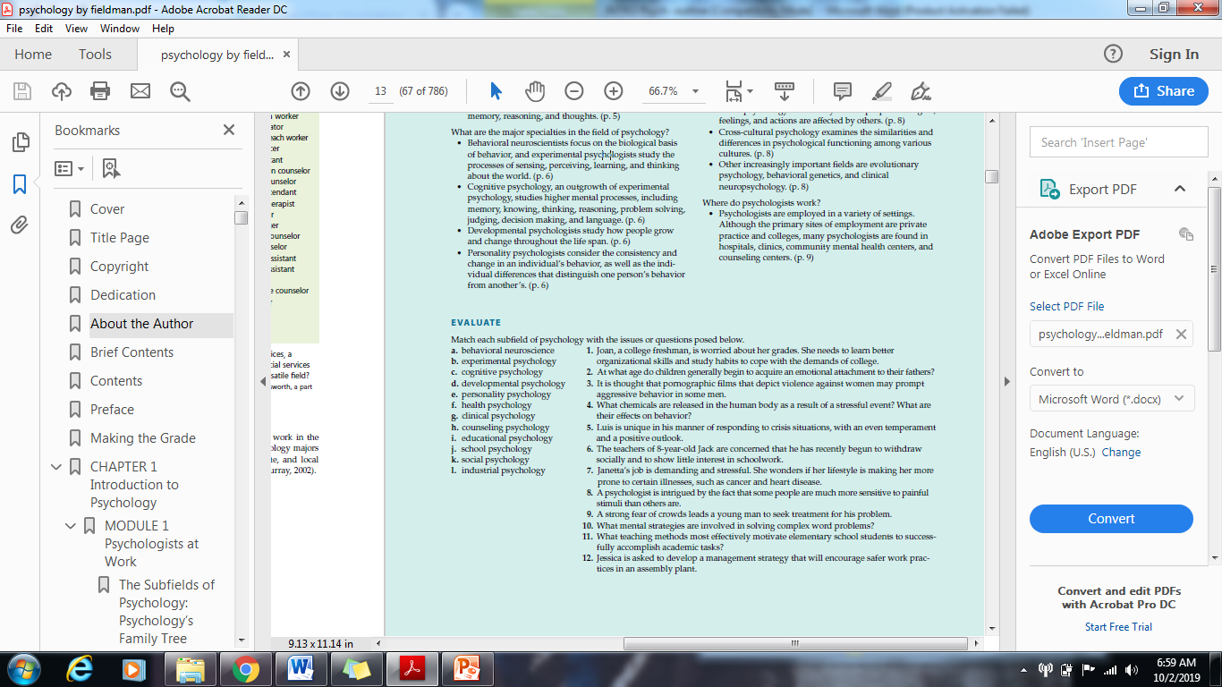

Slide 20
Assignment 1
To you what are different myths about psychology? Discuss.

Slide 21
Thank You :)

